Slide 1
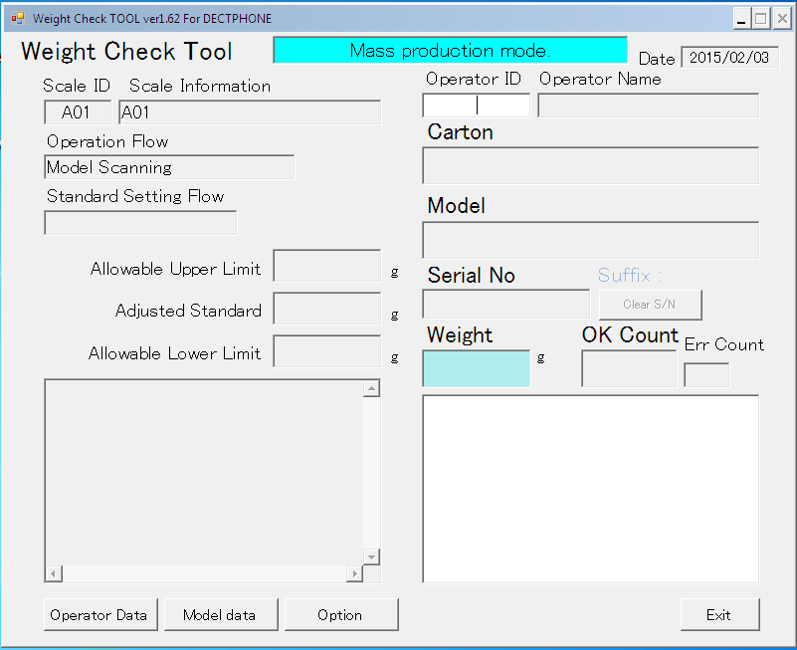
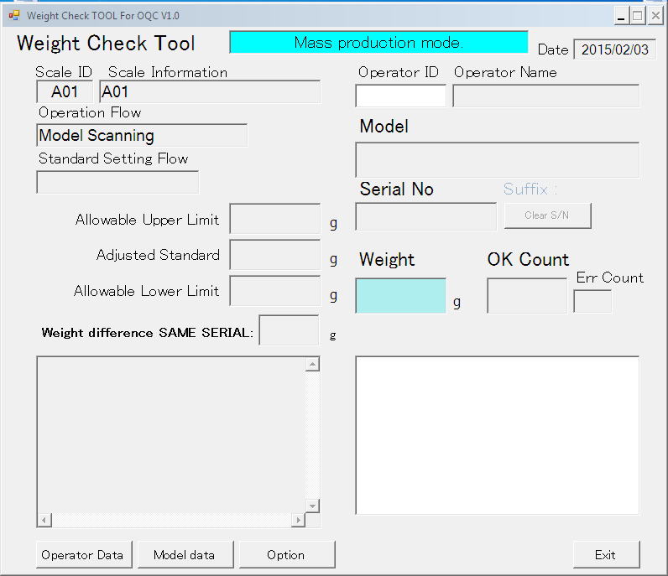
◆Before
◆ After
-OQC check many model same time => waste many time for change model, chang category
Reduction manpower => 16h/month
Cost reduction => 20$/month

Slide 2
Calculate value balance average method: Setting default: 05 pcs
Comparing method:
+ Using balance value of product compare with
average standard data
Change model/change Category:
+ Must be input factory code
-Calculate value balance average method: Setting default: 01 pcs
Comparing method:
+ Using balance value of product compare with
average standard data
+ Compare between 2nd time balance value with 1st time balance value
Change model/change Category:
  + Remove input factory code

